Slide 1
Decision Trees and Clustering

Slide 2
Decision Trees
Supervised algorithm
Can be used for Classification as well as Regression
The leaf nodes (end nodes) give the decision (target value)
How do we choose attributes to split?

Slide 3
Information Gain
To measure how good your split on a particular attribute is, we need some metric
Entropy is roughly the information or uncertainty in the variable’s possible outcome.
A dataset that has only one type of data points has zero entropy
A mixed dataset has higher entropy

Slide 4
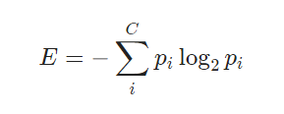
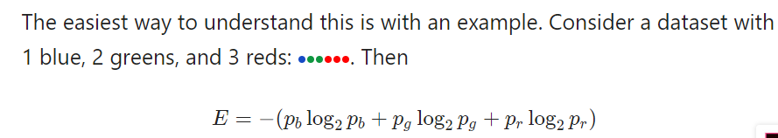
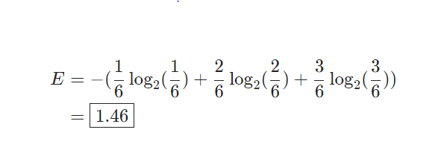

Slide 6
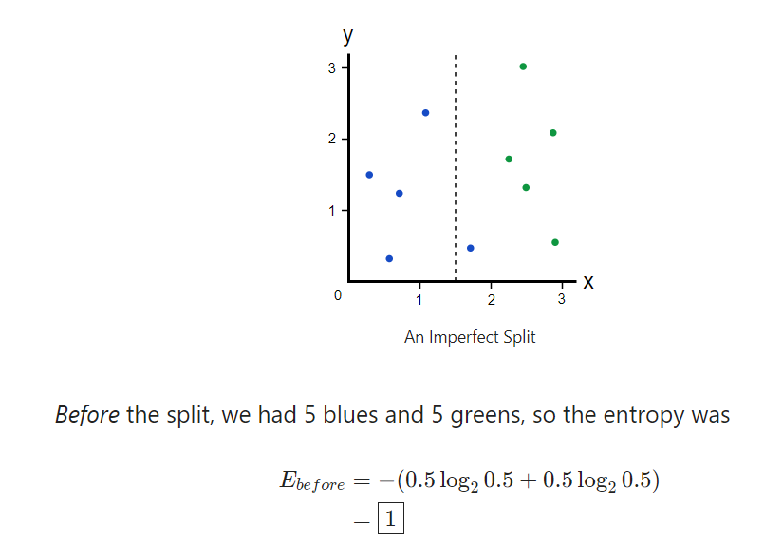

Slide 7
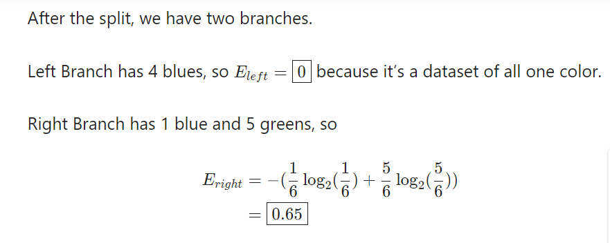

Slide 8
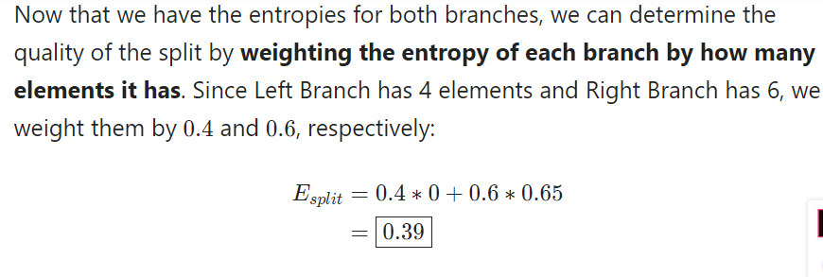

Slide 9
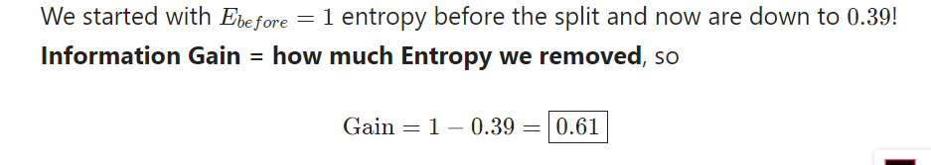
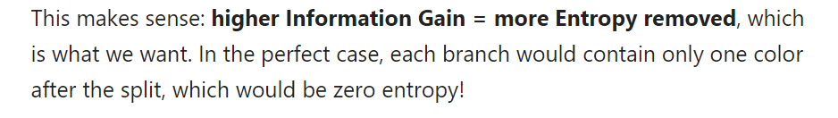

Slide 10
Information Gain in Y due to X
IG(Y|X) = H(Y) – H(Y|X)

Slide 11
Kmeans is not KNN
Go to Jupyter Lab Notebook

Slide 12
Code
DecisionTreeClassifier(max_depth=50, min_samples_split=10, min_samples_leaf=10)
What do all these arguments mean? Look at the documentation here
https://scikit-learn.org/stable/modules/generated/sklearn.tree.DecisionTreeClassifier.html

Slide 13
Code to prepare data (if not done in last lab)
titanic = pd.read_csv("data/titanic.csv")
titanic.head(10)
# choose columns, drop NA, recode
titanic =titanic.loc[:,["Pclass","Sex","Age","SibSp","Parch","Fare","Survived"]]
titanic = titanic.dropna()
le = LabelEncoder()
le.fit(titanic["Sex"])
titanic["Sex"] = le.transform(titanic["Sex"])
train, test = train_test_split(titanic, test_size=0.2)

Slide 14
More Reading
https://www.kdnuggets.com/2020/01/decision-tree-algorithm-explained.html
https://victorzhou.com/blog/information-gain/
https://victorzhou.com/blog/gini-impurity/
https://medium.com/datadriveninvestor/decision-tree-algorithm-with-hands-on-example-e6c2afb40d38
https://stanford.edu/~cpiech/cs221/handouts/kmeans.html
https://builtin.com/data-science/step-step-explanation-principal-component-analysis
https://towardsdatascience.com/a-one-stop-shop-for-principal-component-analysis-5582fb7e0a9c
https://georgemdallas.wordpress.com/2013/10/30/principal-component-analysis-4-dummies-eigenvectors-eigenvalues-and-dimension-reduction/

